Slide 1
Azure-AKS Concepts

Slide 2









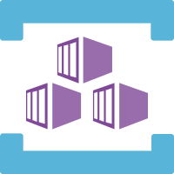









Azure Services Integrated with AKS
Azure
Disks
Azure
Public IP
Azure
AD
Azure
Container
Registry
Azure
Kubernetes
Service
Standard
Load
Balancer
AD
Groups
AKS
Linux & Windows
Nodepools
Azure
MySQL
Azure
DevOps
Azure
Files
Virtual
Network
AD
Users
Azure
Build & Release
Pipelines
Azure
VM
ScaleSets
Azure
DNS
Zones
Azure
Managed
Service
Identity
Storage
Account
Azure
Container Instances
Virtual Nodes
Subnets

Slide 3
Kubernetes - Imperative & Declarative
Kubernetes Fundamentals
Imperative
Declarative
kubectl
YAML & kubectl
Pod
Pod
ReplicaSet
ReplicaSet
Deployment
Deployment
Service
Service

Slide 4

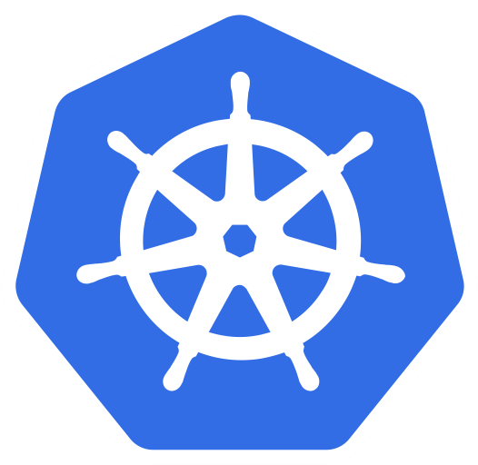
Azure AKS Cluster
http://<External-IP-from-get-service-output>
UserMgmt – LoadBalancer Service
Users
Load Balancer Service
Deployment
Web
App
Environment Variables
POD
ReplicaSet
Init Containers
Azure Disks
Deployment (UserMgmt)
MySQL – ClusterIP Service
Config Map
Storage Class
Environment Variables
Persistent Volume Claim
Volumes
MySql
AKS Storage Azure Disks
Persistent Volumes
Volume Mounts
POD
ReplicaSet
Deployment
Deployment (mysql)
ClusterIP Service

Slide 5
Azure AKS Cluster
http://<External-IP-from-get-service-output>
UserMgmt – LoadBalancer Service
Users
Load Balancer Service
Deployment
Web
App
Environment Variables
POD
ReplicaSet
Init Containers
Deployment (UserMgmt)
MySQL – ExternalName Service
High Availability
Monitoring & Alerting
AKS Storage Azure MySQL Database
Backup & Recovery
Automatic Upgrades
Read Replicas
Azure MySQL
Database
Secure Data at rest and motion

Slide 6
http://<External-IP-from-get-service-output>/app1/file1.html
Azure AKS Cluster
LoadBalancer Service
Users
Load Balancer Service
AKS Storage Azure Files
Deployment
NGINX
NGINX
NGINX
POD
POD
POD
Volumes
ReplicaSet
Deployment
Volume Mounts
Storage Class
Key Advantage with Azure File Shares:
Multiple pods can access the single file share
Azure Storage Account
Persistent Volume Claim
file1.html
file2.html
Persistent Volumes
</>
HTML
</>
HTML
Azure File Shares

Slide 7
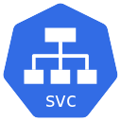

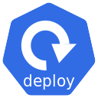


Azure AKS & Nginx Ingress – Context Path Based Routing
Azure
Azure AKS Cluster
Nginx App1
/app1/
/app2/
/
Ingress Service
Nginx App2
Users
Public IP
for Ingress
Controller
Ingress Controller
AKS
Load Balancer
Usermgmt WebApp

Slide 8


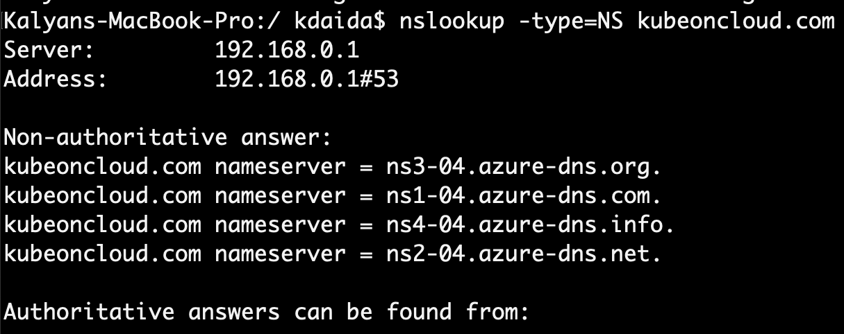
Delegate Domain to Azure DNS
AWS Cloud
Azure Cloud
DNZ Zones
Domain Registrar
kubeoncloud.com
kubeoncloud.com
AWS Route53
Azure DNS Zones

Slide 9

Azure AKS Nginx Ingress Hostname based Routing External DNS
Azure
Azure AKS Cluster
Virtual Machine
Scale Sets
DNS
Zones
Managed
Service
Identity
Nginx App1
External DNS
eapp1.kubeoncloud.com
eapp2.kubeoncloud.com
eapp3.kubeoncloud.com
Nginx App2
Ingress Service
Users
Public IP
for Ingress
Controller
Ingress Controller
AKS
Load Balancer
Usermgmt WebApp

Slide 10
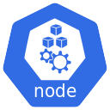
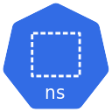
Kubernetes – Requests & Limits
K8s cluster
K8s Node
default namespace
CPU: 8 vcores
(8000m)
Container-1
Container-2
Memory: 32GB
CPU: 500m
CPU: 1000m
CPU: 500m
CPU: 1000m
Mem: 128Mi
Mem: 500Mi
Mem: 128Mi
Mem: 500Mi
Requests
Limits
Requests
Limits

Slide 11
Kubernetes - Namespaces & DNS
K8s cluster
K8s Node
default namespace
dev namespace
qa namespace
App1
App1
App1
app1.default.svc.cluster.local
app1.dev.svc.cluster.local
app1.qa.svc.cluster.local
<service-name>.<namespace-name>.svc.cluster.local

Slide 12
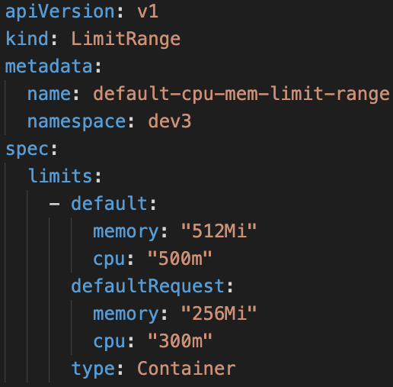
Limit Range
LoadBalancer Service
LoadBalancer Service
LoadBalancer Service
F
F
F
Pod
Pod
Pod
Limit Range Manifest
ReplicaSet
ReplicaSet
ReplicaSet
Deployment
Deployment
Deployment
ClusterIP Service
ClusterIP Service
ClusterIP Service
B
B
B
Pod
Pod
Pod
ReplicaSet
ReplicaSet
ReplicaSet
Deployment
Deployment
Deployment
Deployment
CPU
Memory
CPU
Memory
CPU
Memory
default
Min/Max
default
Min/Max
default
Min/Max
Limit Range (Per Container)
Limit Range (Per Container)
Limit Range (Per Container)
Namespace: dev
Namespace: qa
Namespace: staging

Slide 13
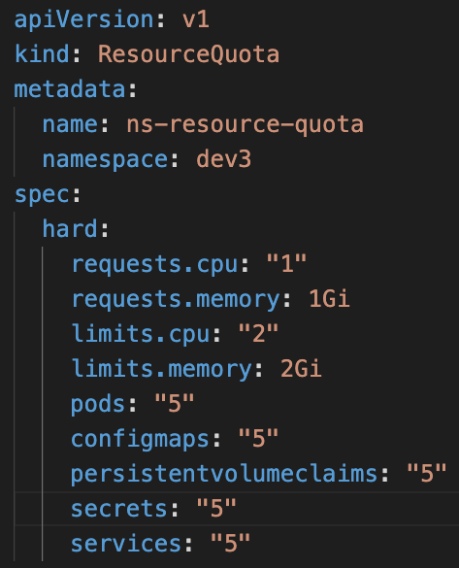
Resource Quota
LoadBalancer Service
LoadBalancer Service
LoadBalancer Service
F
F
F
Resource Quota Manifest
Pod
Pod
Pod
ReplicaSet
ReplicaSet
ReplicaSet
Deployment
Deployment
Deployment
ClusterIP Service
ClusterIP Service
ClusterIP Service
B
B
B
Pod
Pod
Pod
ReplicaSet
ReplicaSet
ReplicaSet
Deployment
Deployment
Deployment
Deployment
CPU
Memory
CPU
Memory
CPU
Memory
Pods
Services
Pods
Services
Pods
Services
Resource Quota
Resource Quota
Resource Quota
Namespace: dev
Namespace: qa
Namespace: staging

Slide 14
Azure AKS Virtual Nodes
Virtual Kubelet
Azure Container Instances
ACI
Azure Virtual Nodes on
AKS
+
=

Slide 15
Azure AKS - Virtual Nodes
Azure Cloud
Azure AKS Cluster
VNET1
AKS Cluster
Control Plane
Node Pool
Virtual Nodes
Azure Container Instance - ACI
Subnet: default
Subnet: virtual-node-aci

Slide 16

Azure ACR and AKS - Integration
Docker Developer
Azure Cloud
Azure Container
Registry
Azure AKS Cluster
Build and Push
Docker Image
Integrate ACR and AKS
Azure AKS Cluster
Control Plane
Pull Docker Image from ACR
http://<public-ip>
Users
Public IP
App1 LB
Nginx App1
AKS
Load Balancer

Slide 17

Pull Docker Images from ACR using Service Principal
Run on Azure AKS Nodepools
Docker Developer
Azure Cloud
Azure Container
Registry
Azure AKS Cluster
Build and Push
Docker Image
Azure AKS Cluster
Control Plane
Pull Docker Image from ACR
docker-server
docker-username
http://<public-ip>
docker-password
Users
Public IP
App1 LB
Nginx App1
AKS
Load Balancer

Slide 18
Pull Docker Images from ACR using Service Principal
Run on Azure Virtual Nodes
Docker Developer
Azure Cloud
Azure Container
Registry
Azure AKS Cluster
Azure AKS Cluster
Control Plane
Build and Push
Docker Image
Pull Docker Image from ACR
docker-server
docker-username
docker-password
http://<public-ip>
Nginx App1
Users
Public IP
App1 LB
Virtual Node - ACI
AKS
Load Balancer

Slide 19
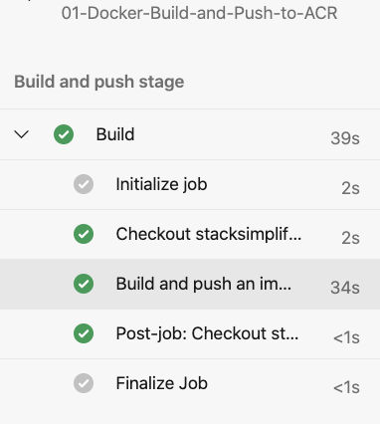

Azure DevOps Pipelines – Build & Push Docker Image to ACR
Azure Cloud
Azure DevOps
Github
Azure Pipelines
(Build & Push)
Azure Container Registry
Developer

Slide 20
Azure DevOps – Build & Push Docker Image to ACR & Deploy to AKS
Azure DevOps
Azure Cloud
Developer
Azure Pipelines
1
2
Stage-1: Build & Push to ACR
4
Stage-2: Deploy to AKS
Github
5
Azure AKS Cluster
3
default namespace
Nginx App1
6
Azure Container Registry

Slide 21
Azure Pipelines – Key Concepts
Pipeline
Stages
Steps
Trigger
Stage-1: Build
Agent
Step-1: script: echo Hello, world!
Job
Stage-2: AA
Step-2: Task-1: Docker Build & Push to ACR
Github
Agent
Stage-3: BB
Job
Step-3: Task-2: Copy Files to Build Artifact Directory
Stage-4: CC
Job
Step-4: Task-3: Publish Artifacts to Azure Pipelines
Developer

Slide 22
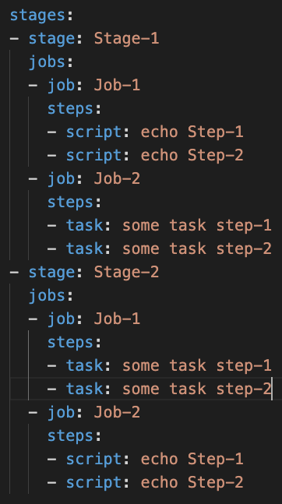
Azure Pipelines – Key Concepts
Stages
Stage-1
Jobs
Job-1
Steps
Step-1: Script
Step-2: Task
Job-2
Steps
Step-1: Task
Step-2: Task
Stage-2
Jobs
Job-1
Steps
Step-1: Script
Step-2: Script
Job-2
Steps
Step-1: Task
Step-2: Task

Slide 23

Azure Pipelines – Starter Pipeline
Goal
Create a Pipeline that will build docker images, push them to Azure Container Registry and Publish Kubernetes Manifests to Azure Pipelines
Part-1
Semi Customized
Part-2
Fully Customized using Starter Pipeline
Task-1
Use pre-defined Docker Build & Push Pipeline
Task-1
Start using Starter pipeline and use Docker Build or Push Docker Images Task
Task-2
Customize Pipeline to Use Copy Files Task
Task-2
Customize Pipeline to Use Copy Files Task
Task-3
Customize Pipeline to Use Publish Build Artifacts Task
Task-3
Customize Pipeline to Use Publish Build Artifacts Task

Slide 24
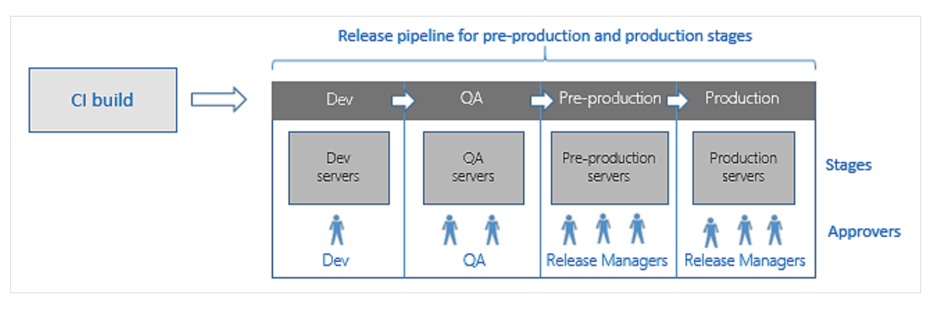
Azure DevOps – Release Pipelines
To achieve Continuous Delivery we use Release Pipelines

Slide 25
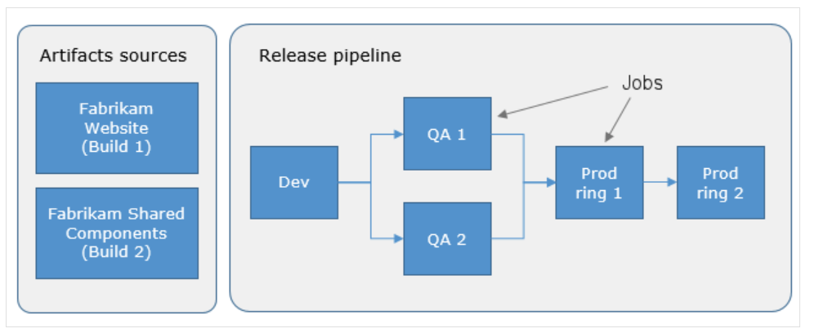
Azure DevOps – Release Pipelines

Slide 26



Developer
Github
Azure DevOps – Release Pipelines
1
2
Azure Cloud
Azure DevOps
Release Pipelines
QA
Azure Pipelines
7
Stage-1: Build & Push to ACR
4
Dev
Staging
12
Prod
3
10
Azure Container Registry
6
5
9
8
Azure AKS Cluster
12
11
14
13
dev namespace
qa namespace
Staging namespace
prod namespace
Nginx App1
Nginx App1
Nginx App1
Nginx App1

Slide 27
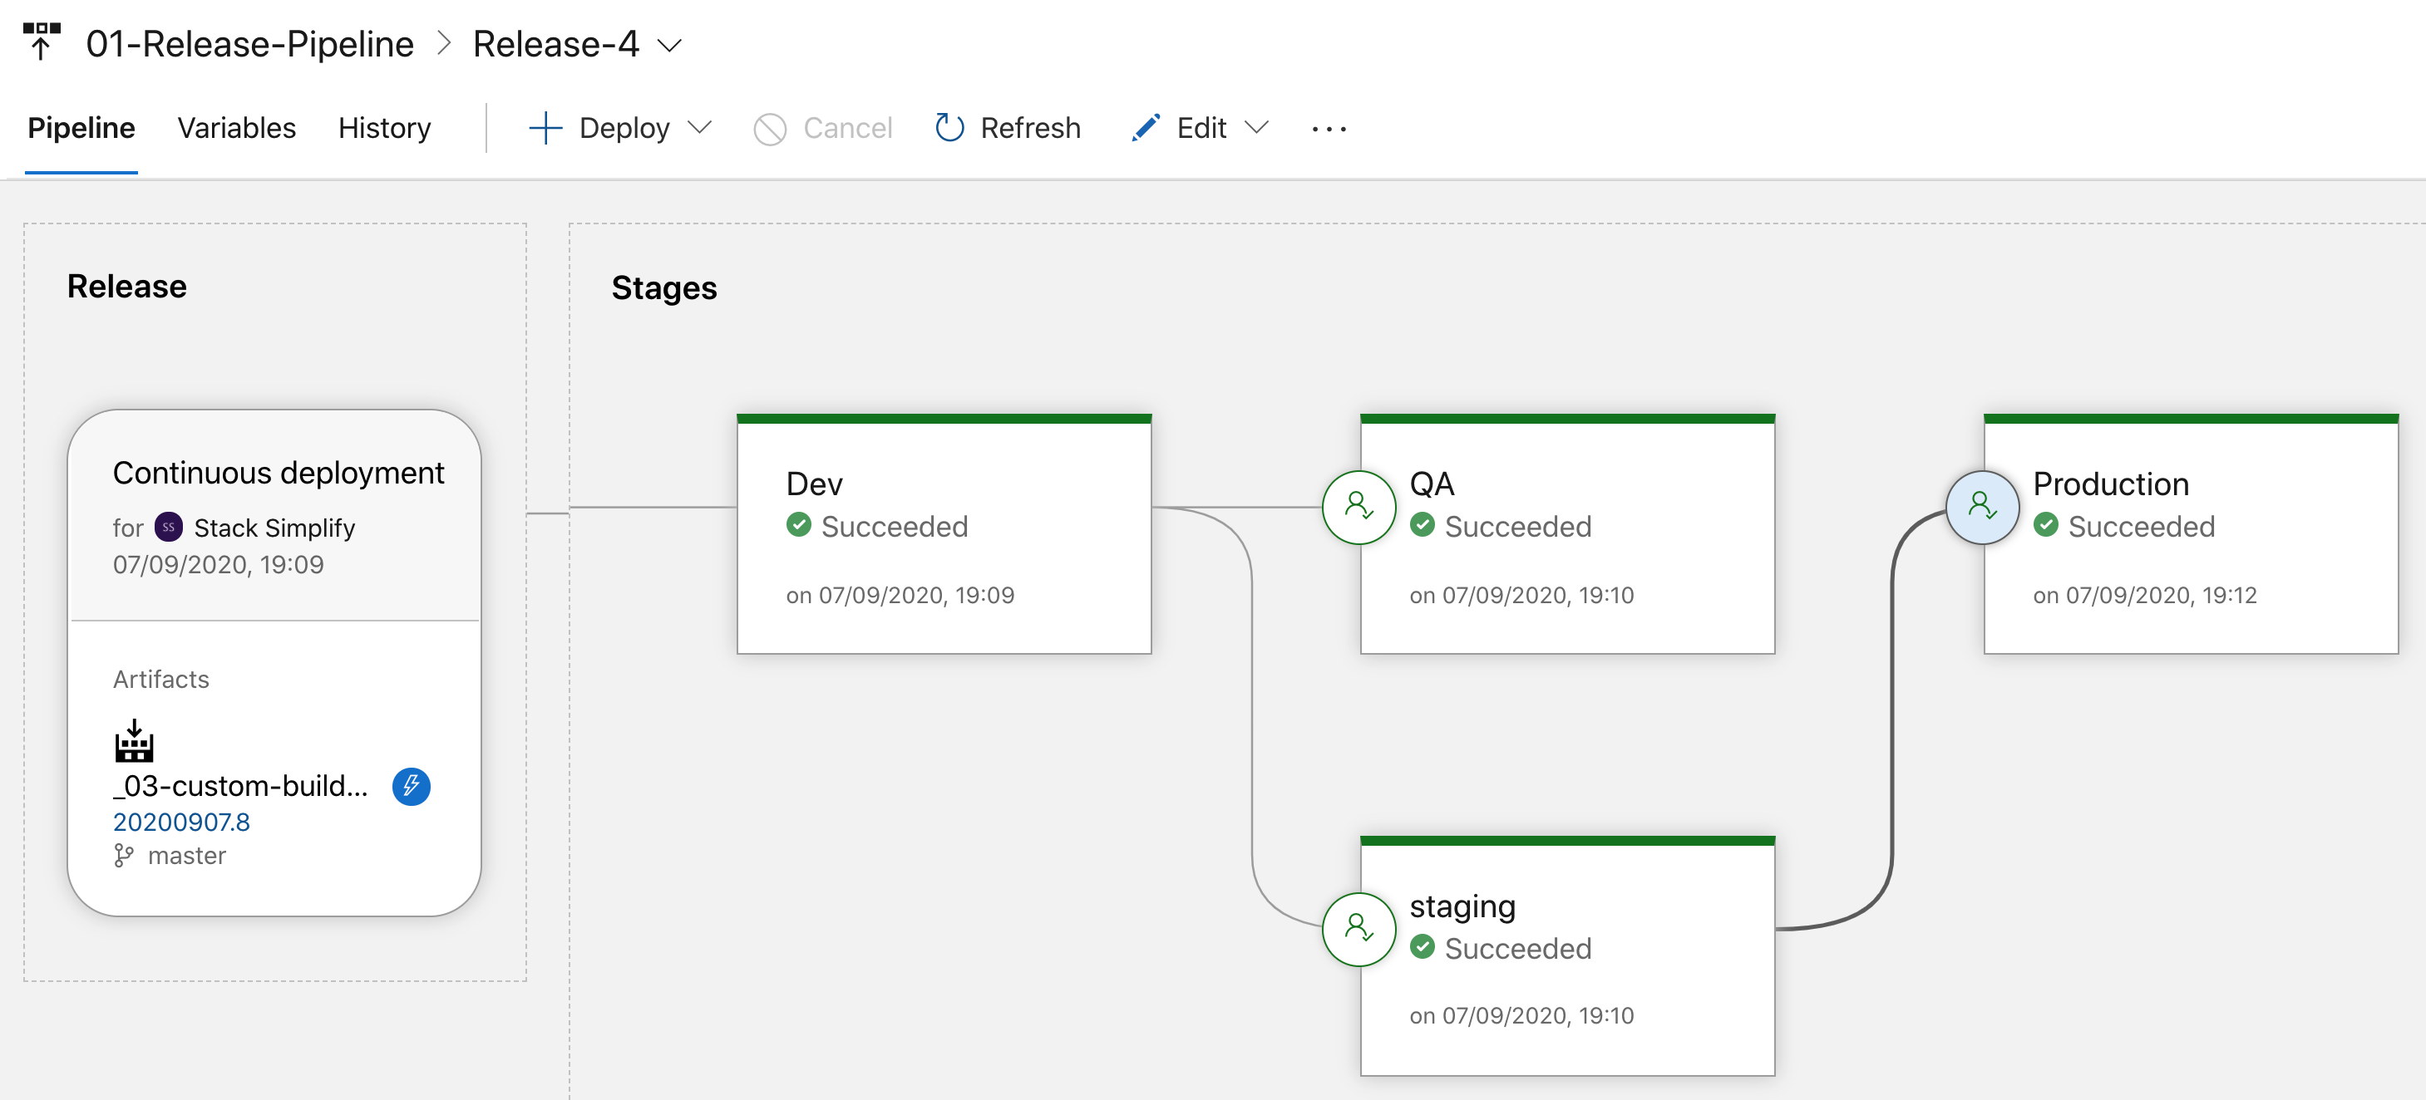
Azure Release Pipelines

Slide 28
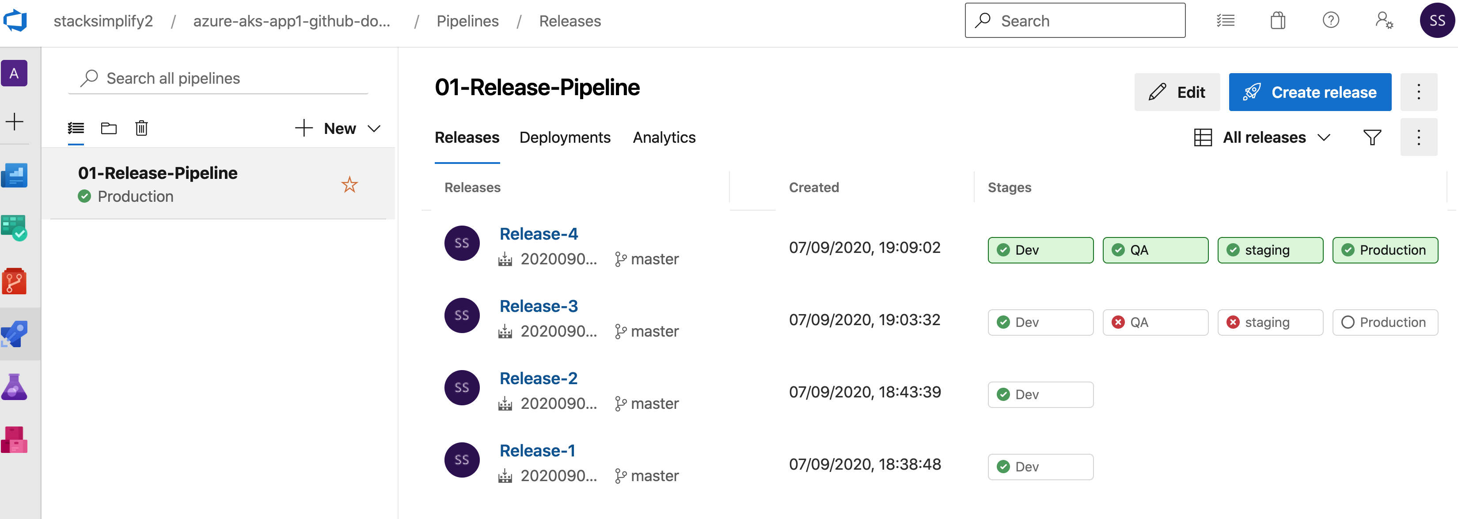
Azure Release Pipelines - Releases

Slide 29
Azure AKS HTTP Application Routing Add On Ingress + External DNS (Automatic Install)
Azure Cloud
Azure AKS Cluster
app1.7b8803340f38495c8402.centralus.aksapp.io
7b8803340f38495c8402.centralus.aksapp.io
DNS Zones
Nginx App1
External DNS
app1.7b8803340f38495c8402.centralus.aksapp.io
app1.7b8803340f38495c8402.centralus.aksapp.io
Users
Public IP
for Ingress
Controller
Ingress Controller
Ingress Service
AKS
Load Balancer
HTTP Application Routing Add On

Slide 30
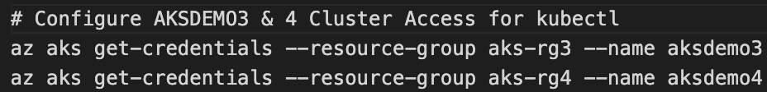




Azure AKS Cluster Access
AKS Cluster - 1
AKS Cluster-1
kubectl
Current Context
AKS Admin
AKS Cluster-2
AKS Cluster - 2

Slide 31

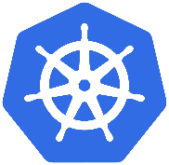

Azure Active Directory Authentication for AKS Admins
Integrate Azure AD and AKS Cluster
Azure Active Directory
Azure AKS Cluster
Azure AD Group: k8sadmins
Your Desktop
kubectl
K8S API Server
Azure AD User: user1aksadmin
Terminal

Slide 32

Azure Active Directory Authentication for AKS Admins
Authentication
Your Desktop
Azure AKS Cluster
Terminal
2
Browser
1
kubectl get nodes
Azure Active Directory
4
3
Credentials Cached
Azure AD User: user1aksadmin
K8S API Server
Azure AD Group: k8sadmins

Slide 33
Kubernetes RBAC
Kubernetes RBAC - Fundamentals
Subjects
API Groups
Resources
Verbs
Users or processes that need access to the Kubernetes API
The k8s API objects that we grant access to
List of actions that can be taken on a resource
Kind: Group, User
core
Pods
Create
Patch
Kind: Service Account
extensions
Deployments
List
get
apps
Services
Watch
Replace
batch
StatefulSets
Delete
Read
Reference: https://kubernetes.io/docs/reference/generated/kubernetes-api/v1.19

Slide 34
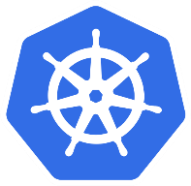
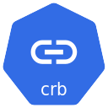

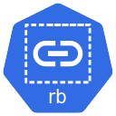

Kubernetes RBAC
Kubernetes Cluster RBAC
Cluster Role Binding
Cluster Role
Namespace: DEV
Namespace: QA
User / Group
(Subject)
Create
(Verb)
Role Binding
Role Binding
Role
Role
User / Group
(Subject)
Create
(Verb)
Pod
(Resource)
User / Group
(Subject)
Create
(Verb)
Pod
(Resource)

Slide 35
Azure Active Directory & Kubernetes RBAC
Azure AKS Kubernetes Cluster
Namespace: DEV
Namespace: QA
Role Binding
Role Binding
Role
Role
User / Group
(Subject)
Create
(Verb)
Pod
(Resource)
User / Group
(Subject)
Create
(Verb)
Pod
(Resource)
Azure AD Group: devaksteam
Azure AD User: aksdev1
Azure Active Directory
Object ID: e6dcdae4-e9ff-4261-81e6-0d08537c4cf8

Slide 36
Azure Active Directory & Kubernetes RBAC
Authentication
k8s Role
k8s Role Binding
Azure AKS Kubernetes Cluster
Namespace: DEV
Role Binding
Azure Active Directory
Role
Integrate Azure AD Group & Kubernetes RBAC
User / Group
(Subject)
get
(Verb)
Pod
(Resource)
Azure AD Group: devaksteam
Credentials Cached
5
Object ID: e6dcdae4-e9ff-42
61-81e6-0d08537c4cf8
3
Access
Granted
kubectl get pods -n dev
4
2
1
Azure AD User: aksdev1
Terminal
Your Desktop

Slide 37
Azure Active Directory & Kubernetes RBAC
Authentication
Azure AKS Kubernetes Cluster
k8s Role
k8s Role Binding
Namespace: DEV
Role Binding
Azure Active Directory
Role
Integrate Azure AD Group & Kubernetes RBAC
User / Group
(Subject)
get
(Verb)
Pod
(Resource)
Azure AD Group: devaksteam
Credentials Cached
Object ID: e6dcdae4-e9ff-42
61-81e6-0d08537c4cf8
3
Namespace: QA
kubectl get pods -n qa
Role Binding
2
Role
1
4
Access
Denied
User / Group
(Subject)
get
(Verb)
Pod
(Resource)
Azure AD User: aksdev1
Terminal
Your Desktop

Slide 38

Azure Active Directory & Kubernetes RBAC
Authentication
k8s Cluster Role
Azure AKS Kubernetes Cluster
Cluster Role Binding
k8s Cluster Role Binding
Azure Active Directory
Cluster Role
Integrate Azure AD Group & Kubernetes RBAC
User / Group
(Subject)
Get
(Verb)
Azure AD Group: aksreadonly
Access
Granted
(Resources)
Object ID: e6dcdae4-e9ff-42
61-81e6-0d08537c4cf8
4
3
Credentials Cached
kubectl get nodes
1
2
Read Only User
Terminal
Azure AD User: aksread1
Your Desktop

Slide 39
Azure Active Directory & Kubernetes RBAC
Authentication
k8s Cluster Role
Azure AKS Kubernetes Cluster
Cluster Role Binding
k8s Cluster Role Binding
Azure Active Directory
Cluster Role
Integrate Azure AD Group & Kubernetes RBAC
User / Group
(Subject)
Get
(Verb)
Azure AD Group: aksreadonly
Access
Denied
(Resources)
Object ID: e6dcdae4-e9ff-42
61-81e6-0d08537c4cf8
4
3
Credentials Cached
kubectl create ns dev
1
2
Read Only User
Terminal
Azure AD User: aksread1
Your Desktop

Slide 40
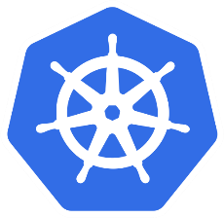
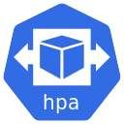
Azure AKS – Autoscaling Nodes & Pods
Azure Kubernetes Service (AKS) Cluster
Automatically auto-scale nodes
Cluster Autoscaler
Scale out
Automatically auto-scale pods
Horizontal Pod Autoscaler
Scale out

Slide 41
System Node Pools
User Node Pools
Virtual Nodes
System Assigned Managed Identity
Kubernetes RBAC
AKS Managed Azure AD
Node Pools
Authentication
Container Registry
Azure CNI
Azure AKS
Cluster
Azure Monitor
Integrations
Load Balancer Standard
Networking
Basics
Azure Policy
Public Cluster
(Restrict Access) / Private
Region
Kubernetes
Version
Zones

Slide 42
Azure AKS
Cluster
Basics
Node Pools
Authentication
Networking
Integrations
Additional
Regions
System Node Pools
System Assigned Managed Identity
Azure CNI
Container Registry
Virtual Network
User Node Pools
Default Subnet
Kubernetes
Version
(Default)
Kubernetes RBAC
(default enabled)
Load Balancer Standard
Azure Monitor
Virtual Nodes
Virtual Nodes Subnet
Zones
AKS Managed Azure AD
Public Cluster
(Restrict Access) / Private
Azure Policy
Windows Node Pools
SSH Public Key

Slide 43
Thank You

